Slide 1
Randomized Algorithms CS648
Lecture 8
Hashing - II

Slide 2
Recap of Last Lecture

Slide 3

Problem Definition
$U=\left\{1,2,…,m\right\}$ called universe
$S⊆U$ and $s=|S|$
$s≪$ $m$
Examples:
$m={10}^{18}$ , $s={10}^{3}$
Aim
Build a data structure for a given $S$to support the search query :
“Does $i∈$ $S$ ?” for any $i∈U$.

Slide 4


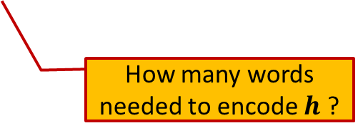
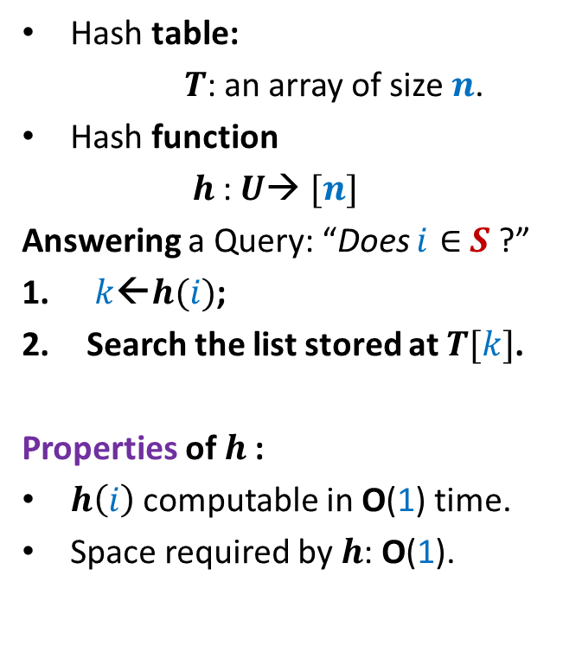

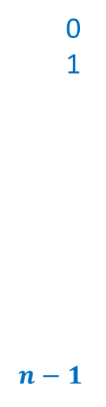

Hashing
Hash table:
$T$: an array of size $n$.
Hash function
$h$: $U$→ $[n]$
Answering a Query: “Does $i∈$ $S$ ?”
$k$←$h(i)$;
Search the list stored at $T[k]$.
Properties of $h$:
$h\left(i\right)$ computable in O(1) time.
Space required by $h$: O(1).
Elements of $S$
$$T$$
0
1
$$n−1$$
$$⋮$$
$$⋮$$
How many words needed to encode $h$ ?

Slide 5
Static Hashing worst Case O(1) search time
Michael Fredman, Janos Komlos, Endre Szemeredy.
Storing a Sparse Table with O(1) Worst Case Access Time.
Journal of the ACM (Volume 31, Issue 3), 1984.
Key idea : universal hash family

Slide 6

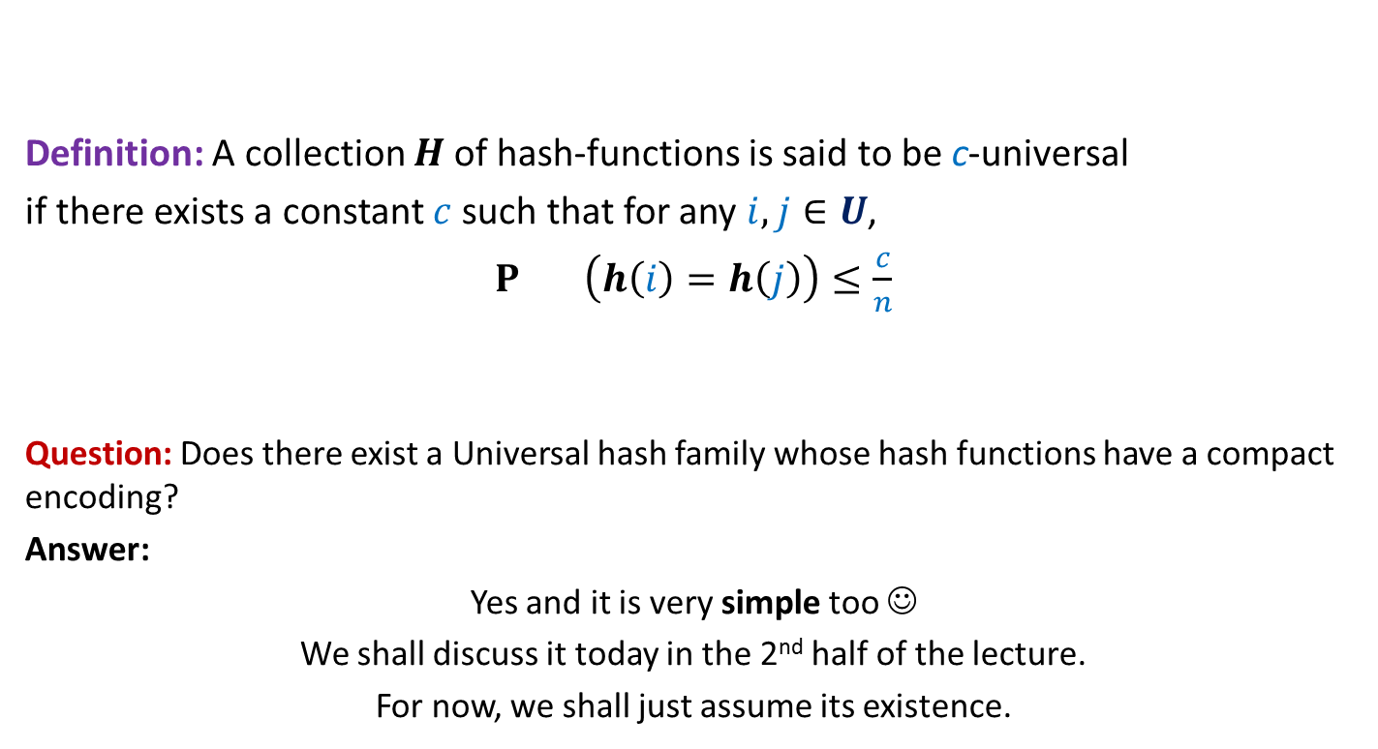
Universal Hash Family
Definition: A collection $H$of hash-functions is said to be c-universal
if there exists a constant $c$such that for any $i,j∈U$,
$P_{} \left(h\left(i\right)=h\left(j\right)\right)≤\frac{c}{n}$
Question: Does there exist a Universal hash family whose hash functions have a compact encoding?
Answer:
Yes and it is very simple too ☺
We shall discuss it today in the 2nd half of the lecture.
For now, we shall just assume its existence.
$$h∈_{r}H$$

Slide 7
Why such a definition for Universal Hash family ?

Slide 8
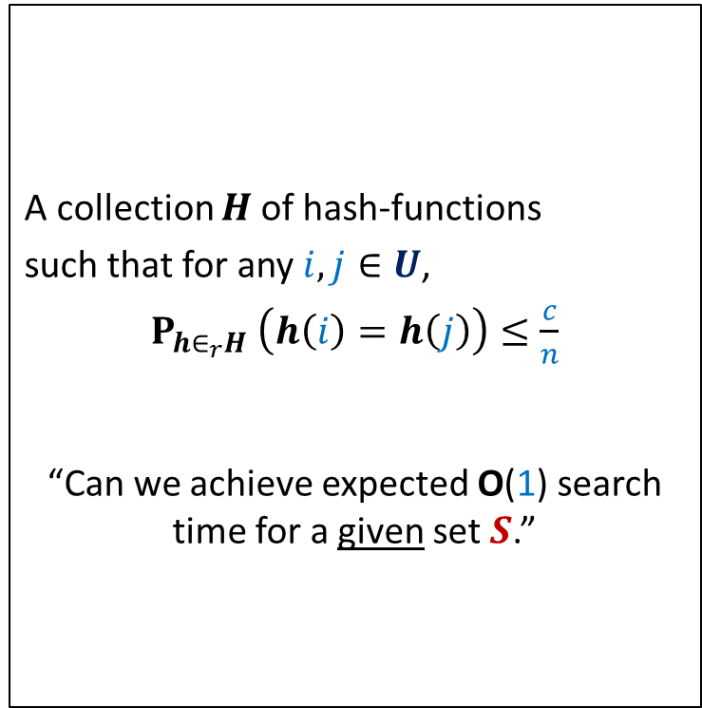
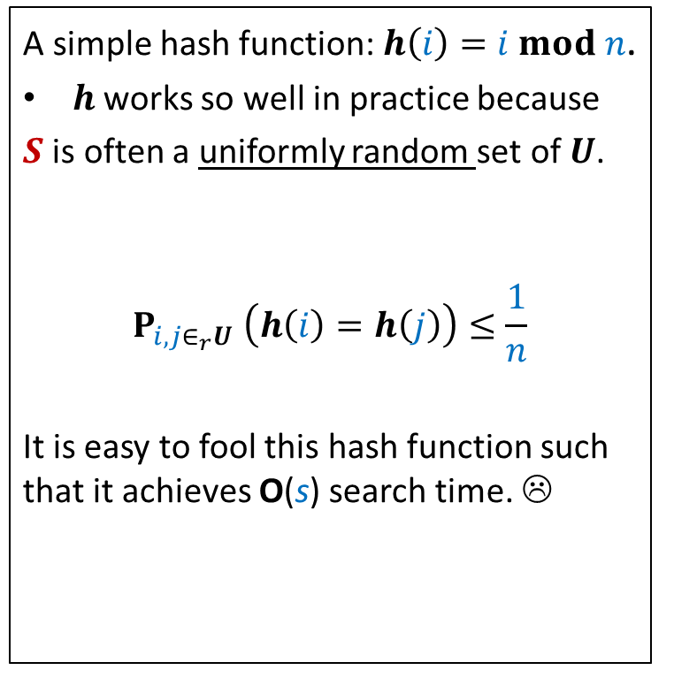
The INSPIRATION
Why does hashing work so well in Practice ?
A simple hash function: $h\left(i\right)=i mod n$.
$h$works so well in practice because
$S$ is often a uniformly random set of $U$.
$$P_{i,j∈_{r}U} \left(h\left(i\right)=h\left(j\right)\right)≤\frac{1}{n}$$
It is easy to fool this hash function such that it achieves O(s) search time. ☹
A collection $H$of hash-functions
such that for any $i,j∈U$,
$P_{h∈_{r}H} \left(h\left(i\right)=h\left(j\right)\right)≤\frac{c}{n}$
“Can we achieve expected O(1) search time for a given set $S$.”
Universal hash family
similar question while
Quick Sort ➔ Randomized Quick Sort

Slide 9
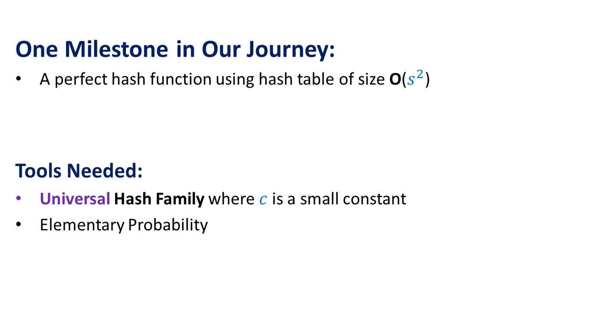
The Journey
One Milestone in Our Journey:
A perfect hash function using hash table of size O($s^{2}$)
Tools Needed:
Universal Hash Family where $c$is a small constant
Elementary Probability

Slide 10
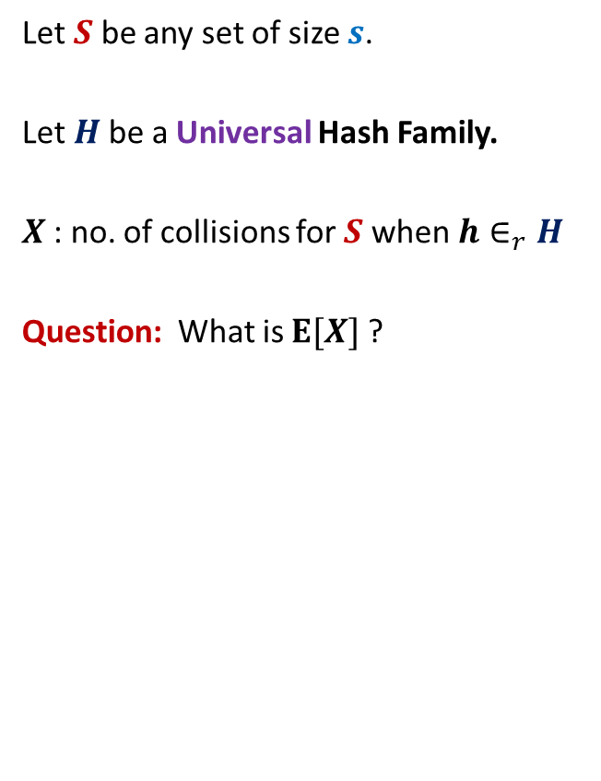


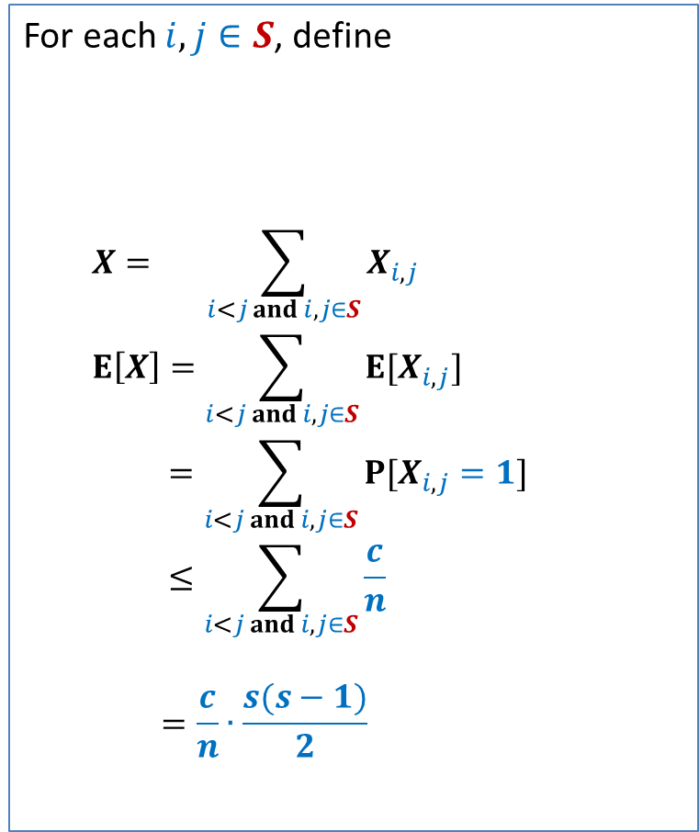
Perfect hashing using O($s^{2}$) space
Let $S$ be any set of size $s$.
Let $H$be a Universal Hash Family.
$X$: no. of collisions for $S$ when $h∈_{r}H$
Question: What is $E[X]$?
For each $i,j∈S$, define
$$X= \sum_{i<j and i,j∈S}{X_{i,j}}$$
$$E\left[X\right]=\sum_{i<j and i,j∈S}{E[X_{i,j}]}$$
$$=\sum_{i<j and i,j∈S}{P[X_{i,j}=1]}$$
$$≤\sum_{i<j and i,j∈S}{\frac{c}{n}}$$
$$=\frac{c}{n}∙\frac{s(s−1)}{2}$$
$$X_{i,j}=\left\{\begin{aligned}1 if h\left(i\right)=h(j) \\ 0 otherwise \end{aligned}\right.$$

Slide 11
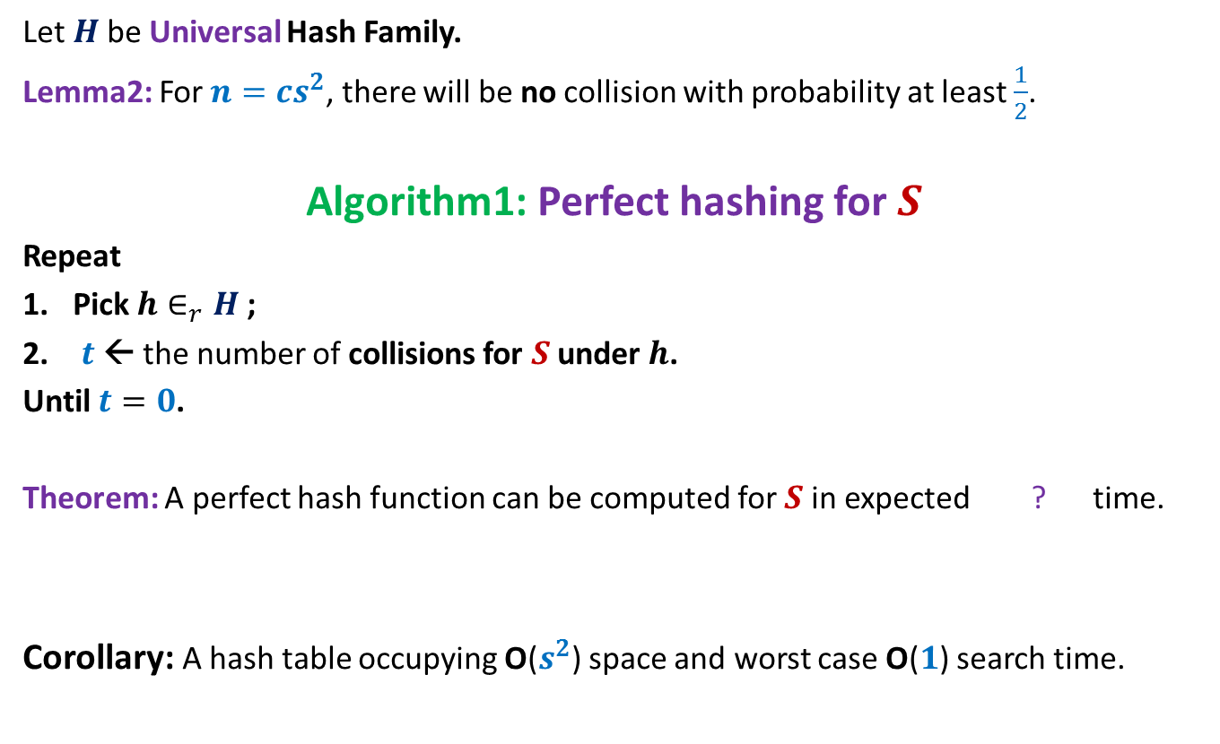

Perfect hashing using O($s^{2}$) space
Let $H$be Universal Hash Family.
Lemma2: For $n=cs^{2}$, there will be no collision with probability at least $\frac{1}{2}$.
Algorithm1: Perfect hashing for $S$
Repeat
Pick $h∈_{r}H$;
$t$← the number of collisions for $S$ under $h$.
Until $t=0$.
Theorem: A perfect hash function can be computed for $S$in expected ? time.
Corollary: A hash table occupying O($s^{2}$) space and worst case O($1$) search time.
O($s^{2}$)

Slide 12
Hashing with Optimal space And Worst case O(1) search time

Slide 13
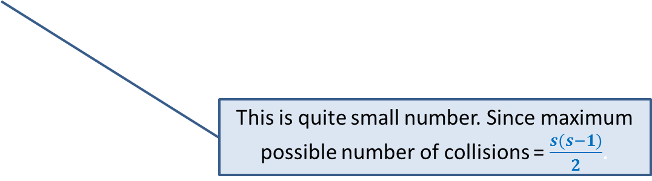

Optimal space hashing with worst case O(1) search time
$H$be Universal Hash Family.
$X$: no. of collisions for $S$ when $h∈_{r}H$?
Lemma1:$E[X]=\frac{c}{n}∙\frac{s(s−1)}{2}$.
Question: What is $E[X$] when $n$ = $s$ ?
Answer: $c\frac{(s−1)}{2}$.
Since we are aiming for linear space, let us see how many collisions will there be for linear space ?
This is quite small number. Since maximum possible number of collisions = $\frac{s(s−1)}{2}$.

Slide 14
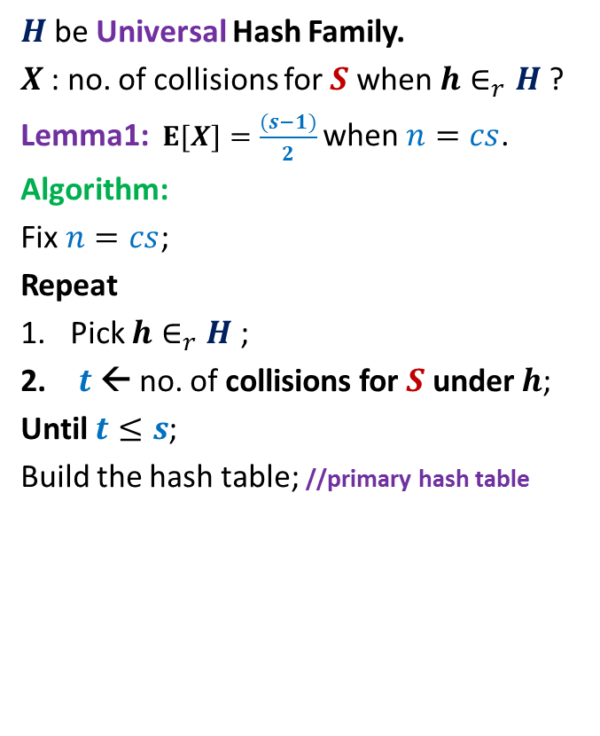
Optimal space hashing with worst case O(1) search time
$H$be Universal Hash Family.
$X$: no. of collisions for $S$ when $h∈_{r}H$?
Lemma1:$E[X]=\frac{(s−1)}{2}$ when $n=cs$.
Algorithm:
Fix $n=cs$;
Repeat
Pick $h∈_{r}H$;
$t$← no. of collisions for $S$ under $h$;
Until $t≤s$;
Build the hash table; //primary hash table
$$T$$
0
1
$$n−1$$

Slide 15
Optimal space hashing with worst case O(1) search time
$H$be Universal Hash Family.
$X$: no. of collisions for $S$ when $h∈_{r}H$?
Lemma1:$E[X]=\frac{(s−1)}{2}$ when $n=cs$.
Algorithm:
Fix $n=cs$;
Repeat
Pick $h∈_{r}H$;
$t$← no. of collisions for $S$ under $h$;
Until $t≤s$;
Build the hash table; //primary hash table
$$T$$
0
1
$$n−1$$

Slide 16
Optimal space hashing with worst case O(1) search time
$H$be Universal Hash Family.
$X$: no. of collisions for $S$ when $h∈_{r}H$?
Lemma1:$E[X]=\frac{(s−1)}{2}$ when $n=cs$.
Algorithm:
Fix $n=cs$;
Repeat
Pick $h∈_{r}H$;
$t$← no. of collisions for $S$ under $h$;
Until $t≤s$;
Build the hash table; //primary hash table
$$T$$
0
1
$$n−1$$

Slide 17
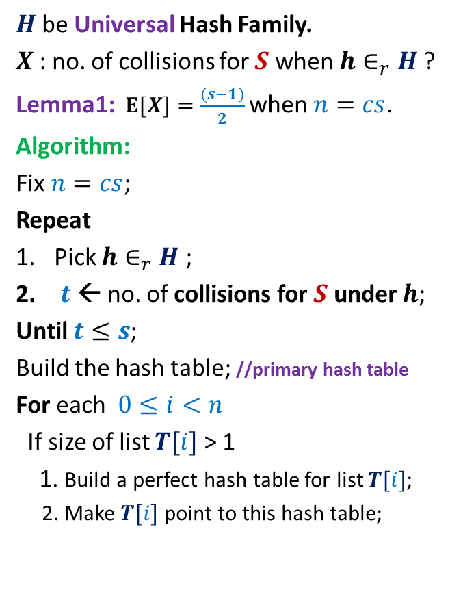
Optimal space hashing with worst case O(1) search time
$H$be Universal Hash Family.
$X$: no. of collisions for $S$ when $h∈_{r}H$?
Lemma1:$E[X]=\frac{(s−1)}{2}$ when $n=cs$.
Algorithm:
Fix $n=cs$;
Repeat
Pick $h∈_{r}H$;
$t$← no. of collisions for $S$ under $h$;
Until $t≤s$;
Build the hash table; //primary hash table
For each $0≤i<n$
If size of list $T[i]$ > 1
1. Build a perfect hash table for list $T[i]$;
2. Make $T[i]$ point to this hash table;
$$T$$
0
1
$$n−1$$

Slide 18
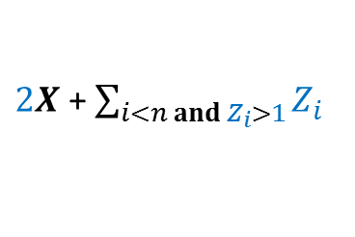

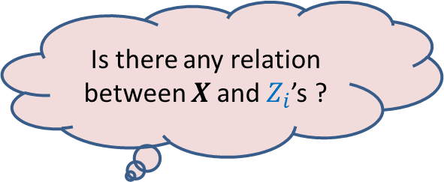
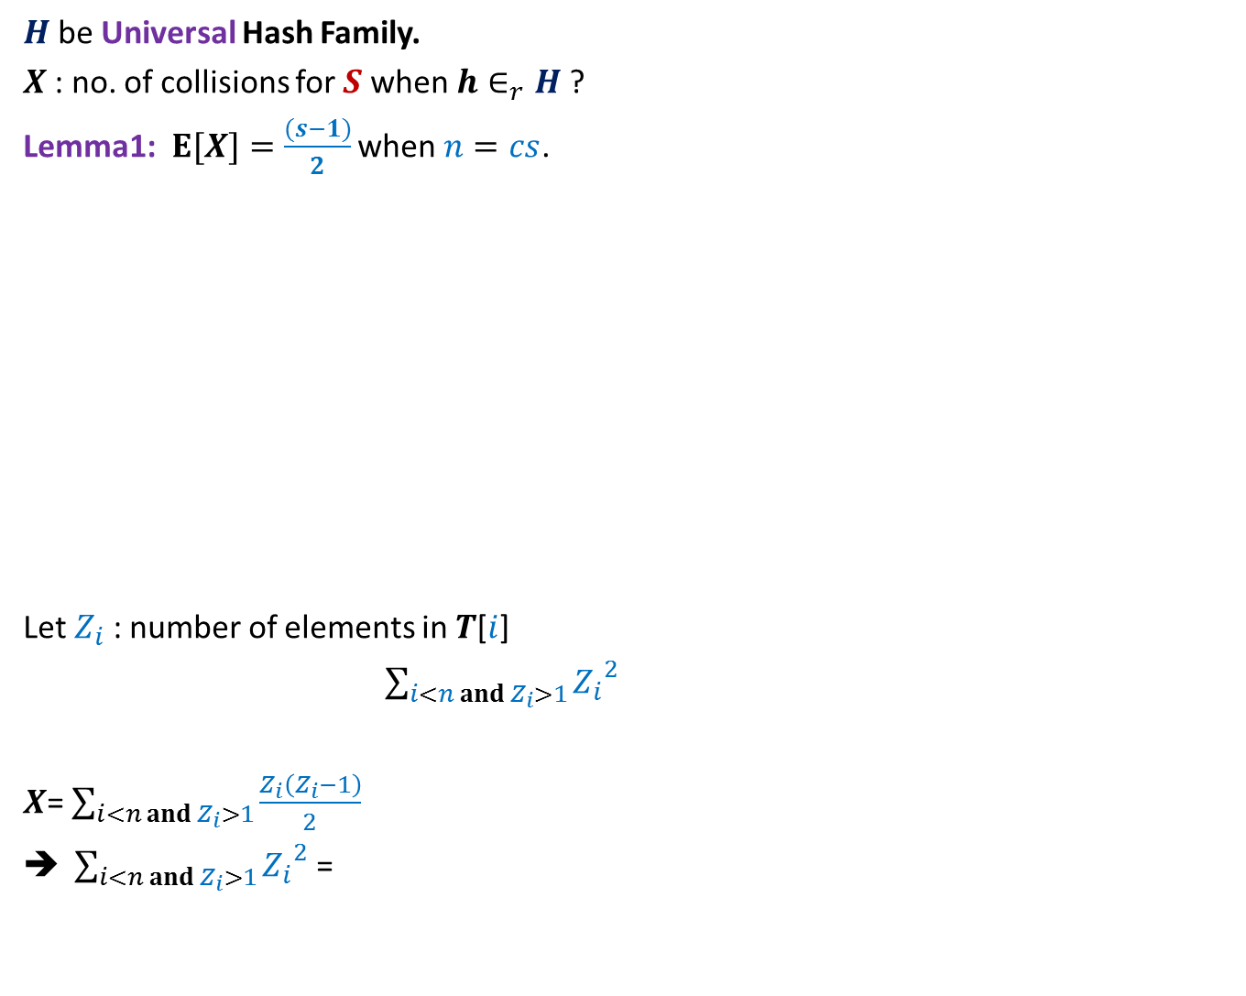
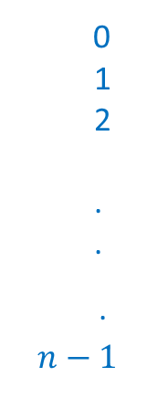
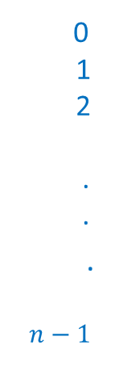

$H$be Universal Hash Family.
$X$: no. of collisions for $S$ when $h∈_{r}H$?
Lemma1:$E[X]=\frac{(s−1)}{2}$ when $n=cs$.
Let $Z_{i}$ : number of elements in $T$[$i$]
$\sum_{i<n and{ Z}_{i}>1}{{Z_{i}}^{2}}$
$X$= $\sum_{i<n and Z_{i}>1}{\frac{Z_{i}\left(Z_{i}−1\right)}{2}}$
$\sum_{i<n and Z_{i}>1}{{Z_{i}}^{2}}$ =
$$T$$
$$T$$
0
1
2
.
.
.
$$n−1$$
0
1
2
.
.
.
$$n−1$$
Extra Space required :
Is there any relation between $X$and $Z_{i}$’s ?
$2X$ + $\sum_{i<n and{ Z}_{i}>1}{Z_{i}}$

Slide 19
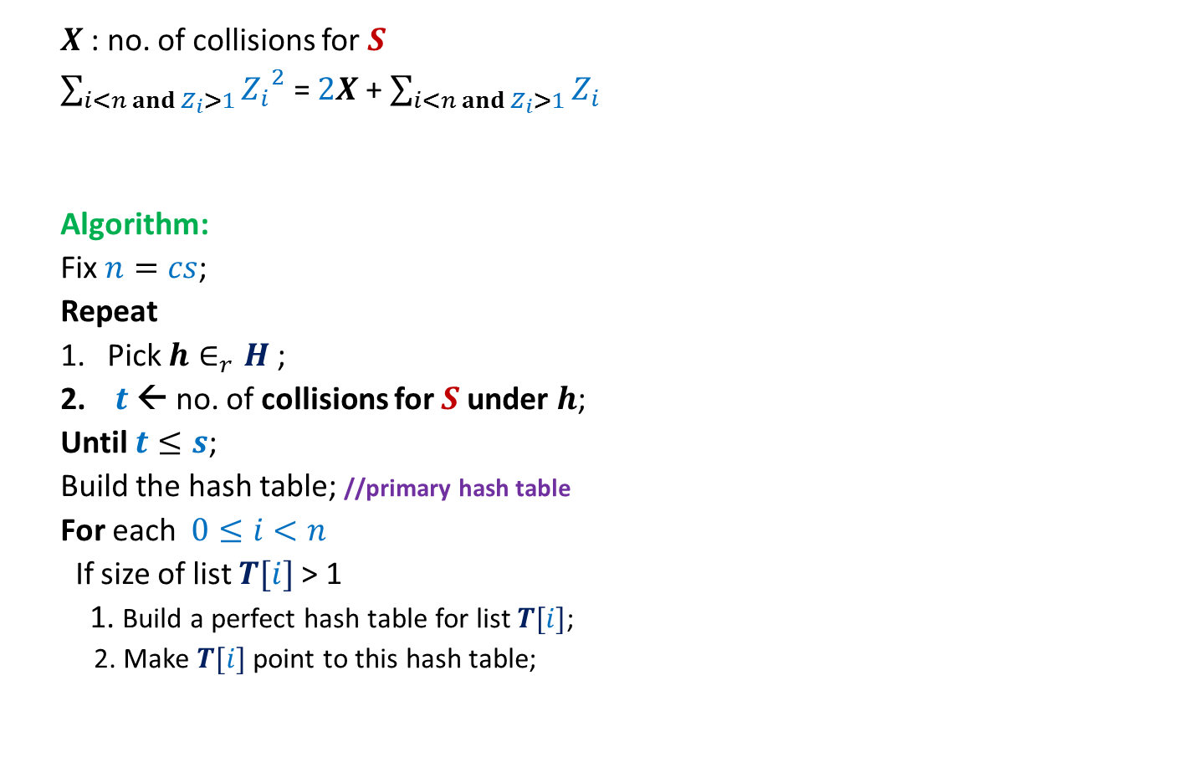

Optimal space hashing with worst case O(1) search time
$X$: no. of collisions for $S$
$\sum_{i<n and Z_{i}>1}{{Z_{i}}^{2}}$ = $2X$ + $\sum_{i<n and{ Z}_{i}>1}{Z_{i}}$
Algorithm:
Fix $n=cs$;
Repeat
Pick $h∈_{r}H$;
$t$← no. of collisions for $S$ under $h$;
Until $t≤s$;
Build the hash table; //primary hash table
For each $0≤i<n$
If size of list $T[i]$ > 1
1. Build a perfect hash table for list $T[i]$;
2. Make $T[i]$ point to this hash table;
$$≤3s$$
$$T$$
0
1
2
.
.
.
$$n−1$$

Slide 20



$U=\left\{1,2,…,m\right\}$ called universe
$S⊆U$ and $s=|S|$
$s≪$ $m$
Examples:
$m={10}^{18}$, $s={10}^{3}$
Theorem:
A given set $S$can be preprocessed in expected O($s$) time
to build a data structure (2-level hash table) of O($s$) size such that
any search query can be answered in worst case O(1) time.
Model of Computation:
Operations involving $\log{s}$
bits take O(1) time.
Word RAM
$$m=polynomial(s)$$
$$\log{m}=O(\log{s})$$

Slide 21
A simple and Compact Universal Hash family

Slide 22


A universal hash family
Let $p$be any prime number greater than $m$.
$$h_{x}\left(j\right)=(jx mod p)$$
Theorem: H={$h_{x}$| $1≤x≤p−1$} is universal.
$$mod n$$
We shall explore the journey for this formulation now.

Slide 23


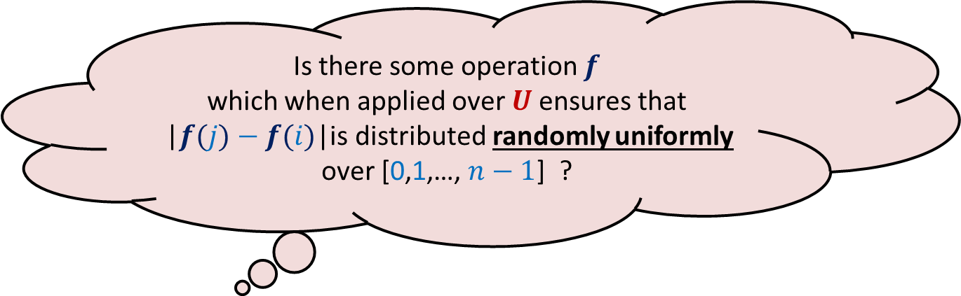
The starting point
The simple hash function: $h\left(i\right)=i mod n$.
Fact: Two elements in $i,j∈U$ are bound to collide if …
Aim: To achieve $P_{h∈_{r}H} \left(h\left(i\right)=h\left(j\right)\right)≤\frac{c}{n}$
$n$ divides |$j−i$|.
Is there some operation $f$
which when applied over $U$ensures that
|$f(j)−f(i)$|is distributed randomly uniformly
over [0,1,…, $n−1$] ?

Slide 24
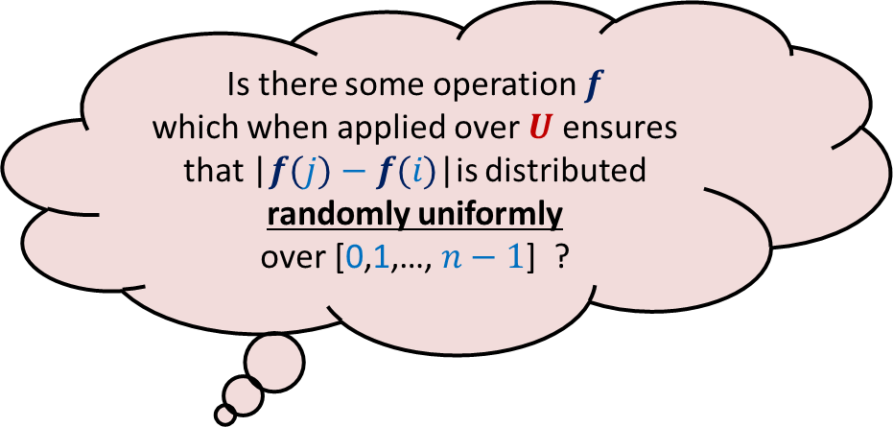
The starting point
The simple hash function: $h\left(i\right)=i mod n$.
Fact: Two elements in $i,j∈U$ are bound to collide if …
Aim: To achieve $P_{h∈_{r}H} \left(h\left(i\right)=h\left(j\right)\right)≤\frac{c}{n}$
$n$ divides |$j−i$|.
Is there some operation $f$
which when applied over $U$ensures
that |$f(j)−f(i)$|is distributed randomly uniformly
over [0,1,…, $n−1$] ?

Slide 25
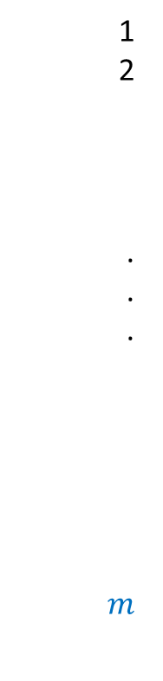


1
2
.
.
.
$$m$$
$$f$$
$$i$$
Is there some operation $f$
which when applied over $U$ensures
that |$f(j)−f(i)$|is distributed randomly uniformly
over [0,1,…, $n−1$] ?
$$j$$
Let us recall some basic facts about mod operation

Slide 26
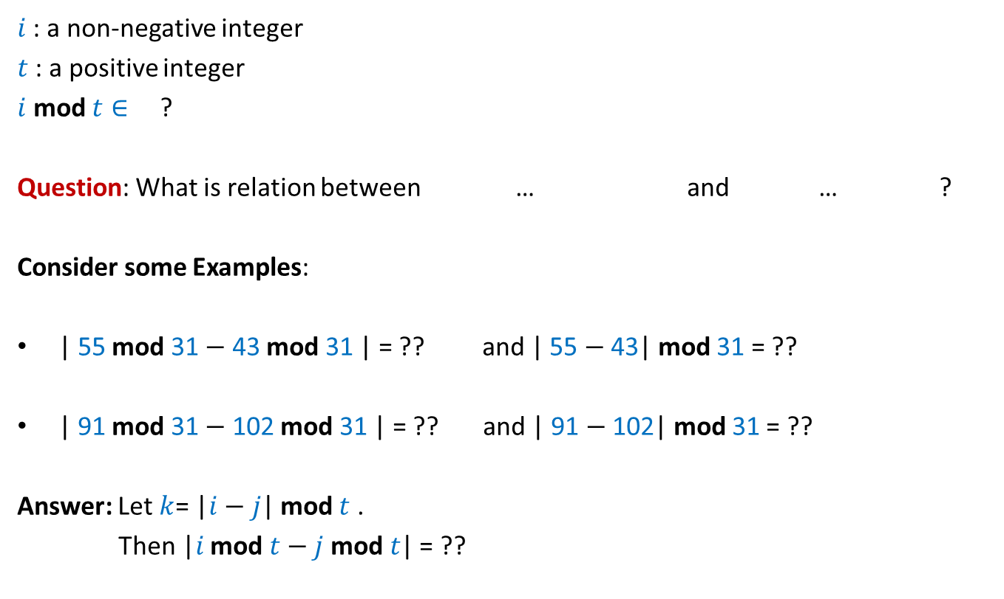
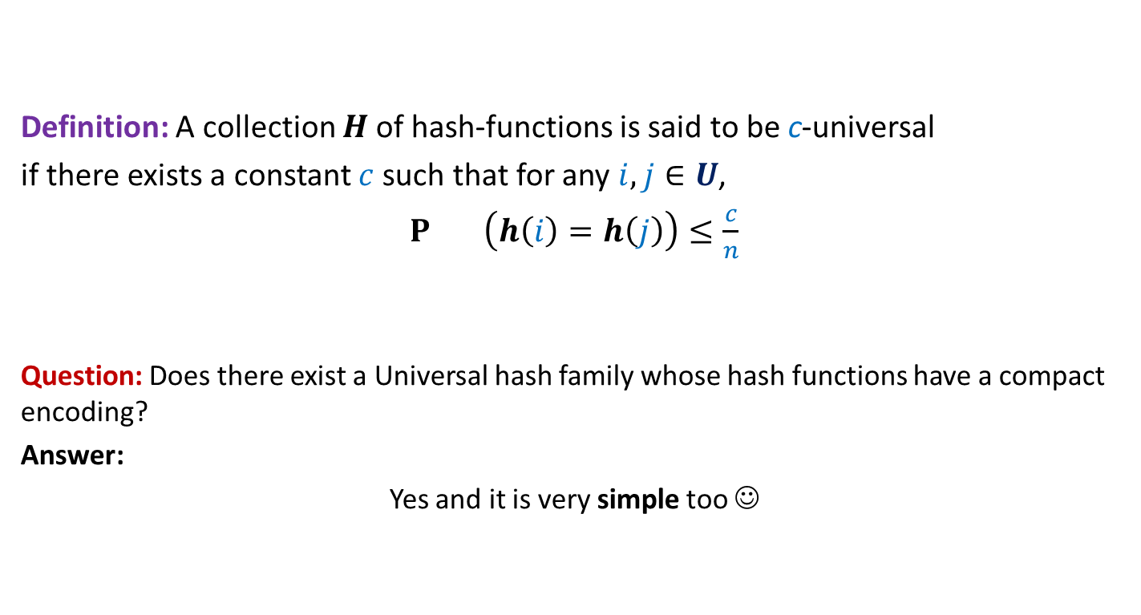

mod operation
$i$ : a non-negative integer
$t$ : a positive integer
$i$ mod $t∈$ ?
Question: What is relation between … and … ?
Consider some Examples:
| 55 mod 31 $−$ 43 mod 31 | = ?? and | 55 $−$43| mod 31 = ??
| 91 mod 31 $−$ 102 mod 31 | = ?? and | 91 $−$102| mod 31 = ??
Answer: Let $k$= |$i−j$| mod $t$ .
Then |$i$ mod $t−j \text{mod} t$| = ??
{0,1,…,$t−1$}.
|$i$ mod $t−j \text{mod} t$|
|$i−j$|mod $t$
12
12
20
11
$∈${$k$, $t−k$}

Slide 27
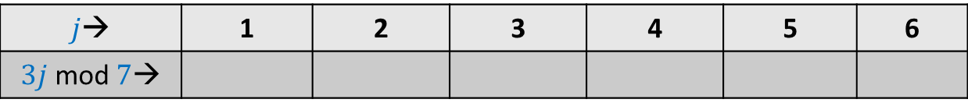
mod operation
$p$ : a prime number
$A$: {$1,2,…,p−1$}
Consider any $i∈A$.
Question: What can we say about set $A_{i}$ = { $ij mod p | j∈A$} ?
Example: $p=7$
$j$→ | 1 | 2 | 3 | 4 | 5 | 6
$3j$ mod $7$→
3
6
2
5
1
4

Slide 28
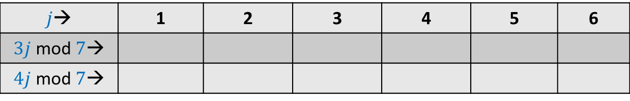
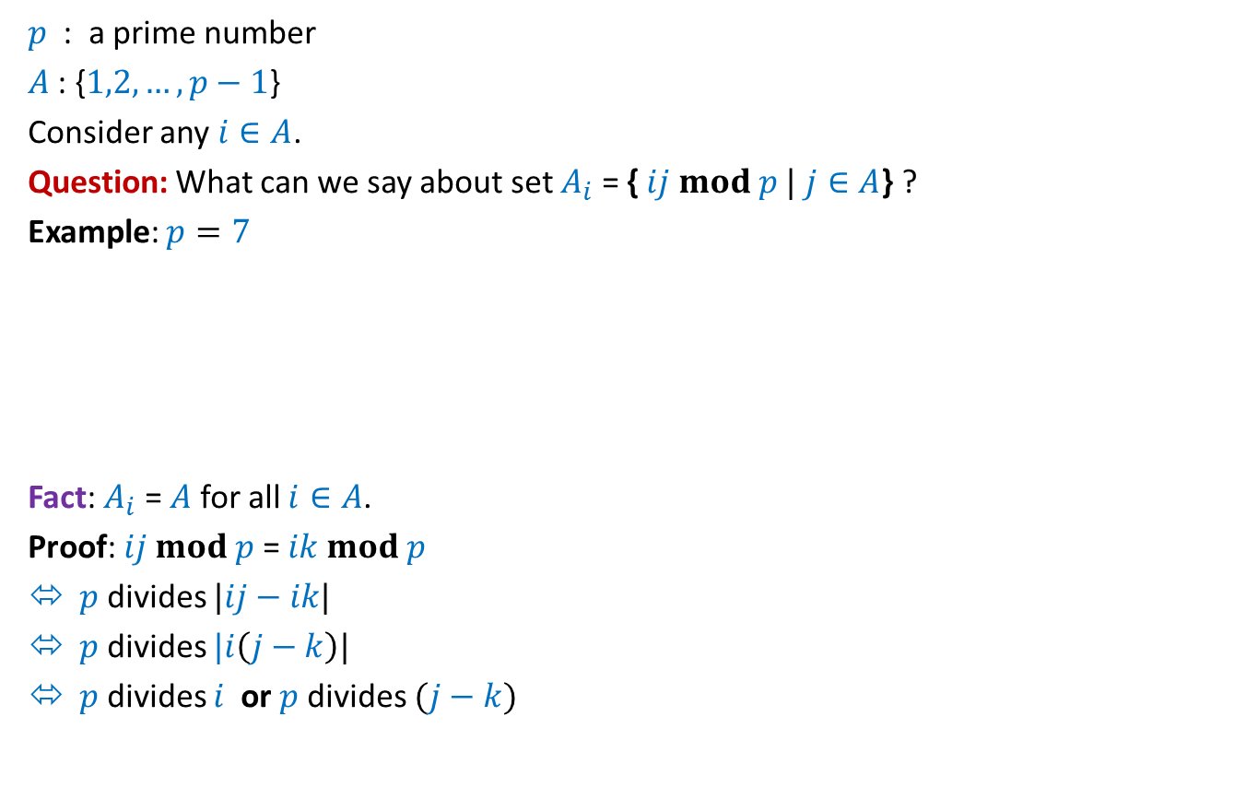
mod operation
$p$ : a prime number
$A$: {$1,2,…,p−1$}
Consider any $i∈A$.
Question: What can we say about set $A_{i}$ = { $ij mod p |$ $j∈A$} ?
Example: $p=7$
Fact: $A_{i}$ = $A$ for all $i∈A$.
Proof: $ij mod p$= $ik mod p$
$p$ divides $|ij−ik|$
$p$ divides $|i\left(j−k\right)|$
$p$ divides $i$ or $p$divides $(j−k)$
$j$→ | 1 | 2 | 3 | 4 | 5 | 6
$3j$ mod $7$→
$4j$ mod $7$→
3
6
2
5
1
4
4 1 5 2 6 3
Not possible

Slide 29
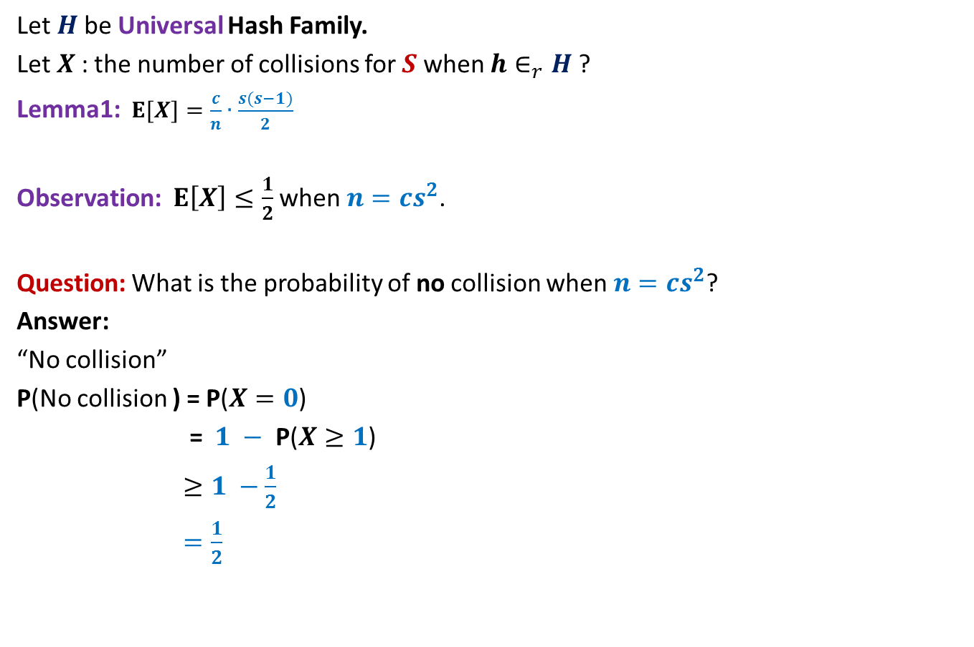

mod operation
$p$ : a prime number
$A$: {$1,2,…,p−1$}
Consider any $i∈A$.
Define set $A_{i}$ = { $ij mod p |$ $j∈A$} ?
Fact: $A_{i}$ = $A$ for all $i∈A$.
Question: If $x∈_{r}A$, then what can we say about $(xi mod p)$?
Answer:
distributed randomly uniformly over $A$.
$h_{x}\left(i\right)=(ix mod p) mod n$ ?
Can you now get the Insight for the hash function ?

Slide 30
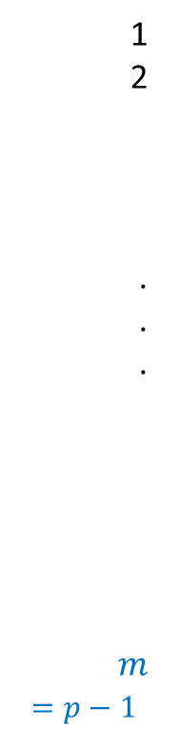

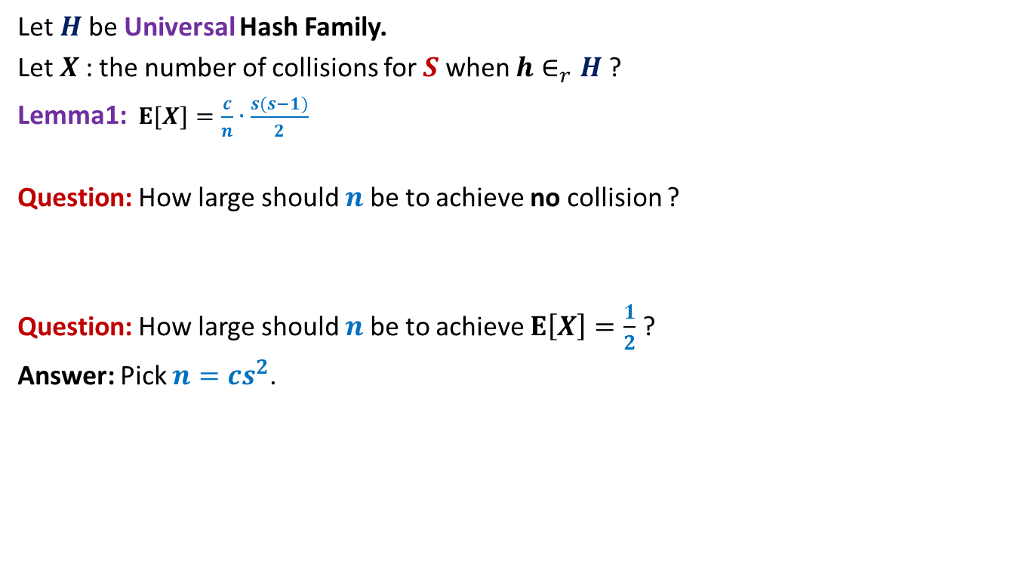
1
2
.
.
.
$$m$$
$=p−1$
$$h_{x}\left(i\right)=(ix mod p) mod n$$
Good fact: ☺
An element $i$ is mapped to
a random element in {$0,…,n−1$}.
Slightly bad fact :☹
Once element $i$ is mapped to a location,
the mapping of $i+Δ$is no more random.
So it is not clear whether
|$h_{x}\left(i+Δ\right)$ $− h_{x}\left(i\right)$| is mapped
uniformly randomly over {0,…, $n−1$}.
➔ Let us analyse $h_{x}$ more closely.
$$ix mod p$$
$$i$$
$$i+Δ$$

Slide 31
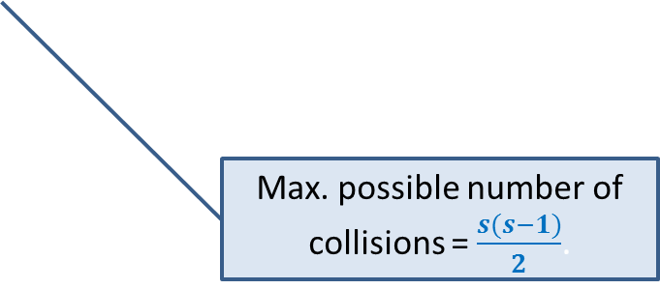


Probability of collision between $i$ and $i+Δ$
Let $h_{x}\left(j\right)=(jx mod p) mod n$
$i$ and $i+Δ$ will collide under $h_{x}$if
|$ix$mod $p−\left(i+Δ\right)x$mod $p$| is divisible by $n$.
Question: What is relation between |$ix$mod $p−\left(i+Δ\right)x$mod $p$| and $Δx$mod $p$ ?
Answer: |$ix$mod $p−\left(i+Δ\right)x$mod $p$| is …
either $Δx$mod $p$
or $p−Δx\text{mod} p$.

Slide 32

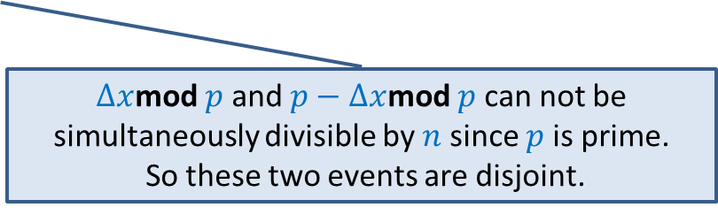
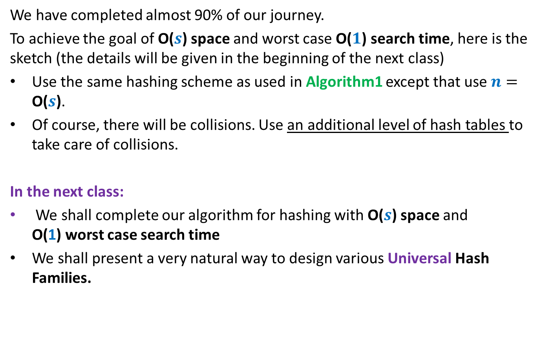


Probability of collision between $i$ and $i+Δ$
Let $h_{x}\left(j\right)=(jx mod p) mod n$
Lemma: If $i$ and $i+Δ$ collide under $h_{x}$, then
either $Δx$mod $p$ is divisible by $n$
or $p−Δx\text{mod} p$ is divisible by $n$.
{$Δx$mod $p$ | $1≤x≤p−1$} = ??
Let $x∈_{r}\text{\{}1\text{,…,} p−1\text{\}}$.
Probability of collision between $i$ and $i+Δ$ =
$≤$ P( ? or ? )
$=$ 2 P($Δx$mod $p$ is divisible of $n$)
= $2\frac{\left\lfloor \frac{p−1}{n}\right\rfloor }{p−1}$
$≤\frac{2}{n}$
Students must realize that it is a necessary condition and not sufficient condition for collision. To realize it, study the example given at the second last slide of this lecture.
{$1$,…, $p−1$}
$Δx$mod $p$ is divisible of $n$
$p−Δx\text{mod} p$ is divisible by $n$
$Δx$mod $p$ and $p−Δx$mod $p$ can not be simultaneously divisible by $n$since $p$is prime.
So these two events are disjoint.

Slide 33

Theorem:
Let $h_{x}\left(j\right)=(jx mod p) mod n$,
then H={$h_{x}$| $1≤x≤p−1$} is 2-universal.

Slide 34


Example (referred to in slide 15)
$p=7$, $n=4.$
$h_{x}\left(j\right)=(jx mod 7) mod 4$.
Observe that $\left\lfloor \frac{p−1}{n}\right\rfloor$=1
Question: How many collisions between
$2 a$nd $3$ ?
Answer: two (for $x$=3,4).
Here $Δx mod 7= 4$ for $x$=4.
And $7−Δx mod 7= 4$ for $x$=3
$$\text{Question}\text{:} \text{How} \text{many} \text{collisions} \text{between} 2 a\text{nd} \text{4}\text{ ?}$$
Answer: No collisions!
(although $Δx mod 7= 4$ for $x=2$ here.)
$x$
1 2 3 4 5 6
$j$
1
2
3
4
5
6
1 | 2 | 3 | 4 | 5 | 6
2 | 4 | 6 | 1 | 3 | 5
3 | 6 | 2 | 5 | 1 | 4
4 | 1 | 5 | 2 | 6 | 3
5 | 3 | 1 | 6 | 4 | 2
6 | 5 | 4 | 3 | 2 | 1
Table storing $jx mod 7$

Slide 35
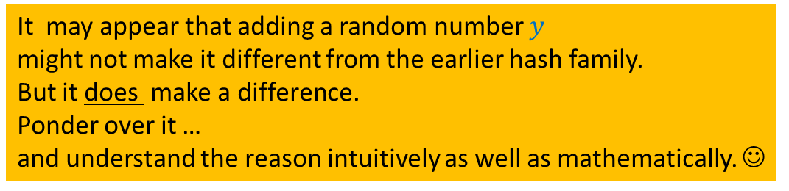
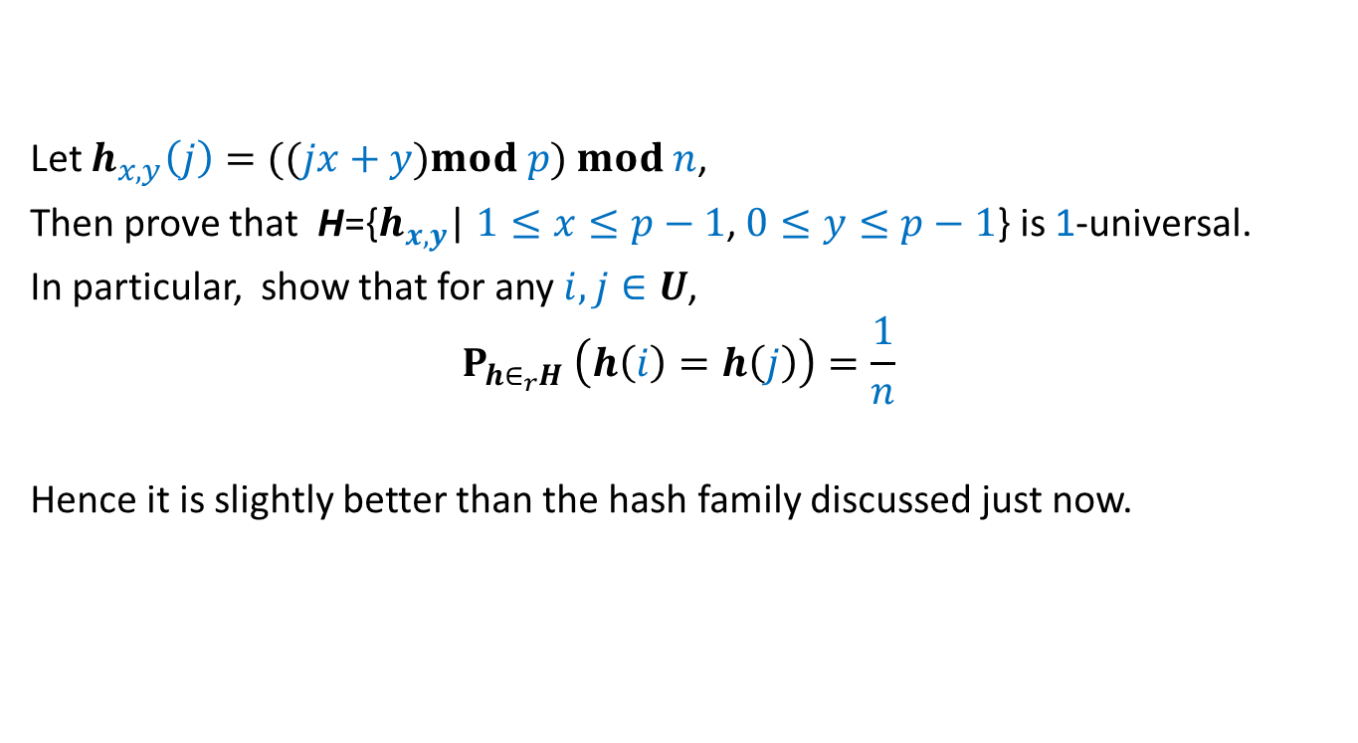
Homework:
Let $h_{x,y}\left(j\right)=((jx+y)mod p) mod n$,
Then prove that H={$h_{x,y}$| $1≤x≤p−1$, $0≤y≤p−1$} is 1-universal.
In particular, show that for any $i,j∈U$,
$$P_{h∈_{r}H} \left(h\left(i\right)=h\left(j\right)\right)=\frac{1}{n}$$
Hence it is slightly better than the hash family discussed just now.
It may appear that adding a random number $y$
might not make it different from the earlier hash family.
But it does make a difference.
Ponder over it …
and understand the reason intuitively as well as mathematically. ☺

